Slide 1
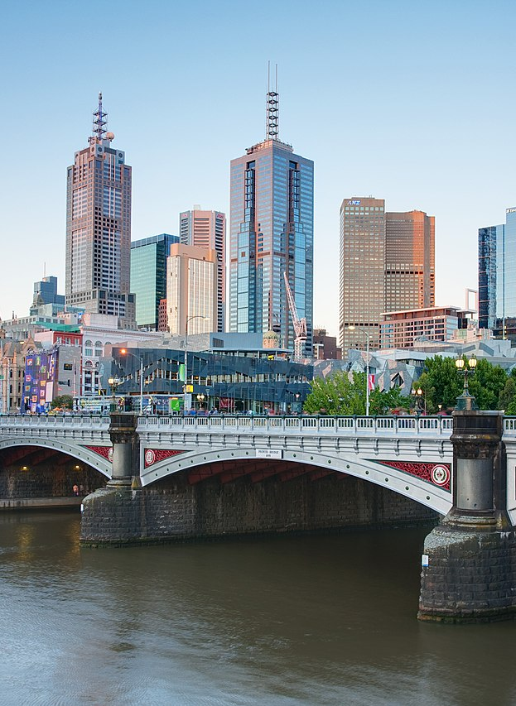
Suburbs Popularity in Melbourne and Price Expectations
This research seeks to explore:
In-demand suburbs of Melbourne in the properties market
How realistic are the buyers' expectations of the market.
This Photo by Unknown author is licensed under CC BY-SA.

Slide 2
Hypotheses
The hypotheses tested in this research are:
It is more feasible to find and purchase a property in the north and east of Melbourne.
Buyers have lower expectations of the market prices than what they eventually pay for a property.

Slide 3
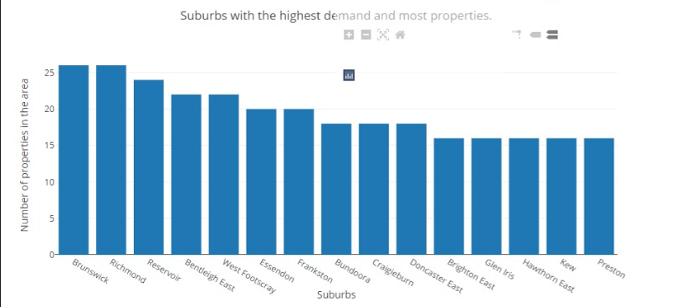
The bar graph demonstrates:​
Areas with highest listings are mainly concentrated in north, north-east and north-west of CBD.
All North: 135 listings
East: 74 listings
In-demand suburbs not in north or east:
Brighton East(South - 26)
Bentleigh East ( south - 24)
Frankston (South - 20)
West Footscray (West – 22)

Slide 4
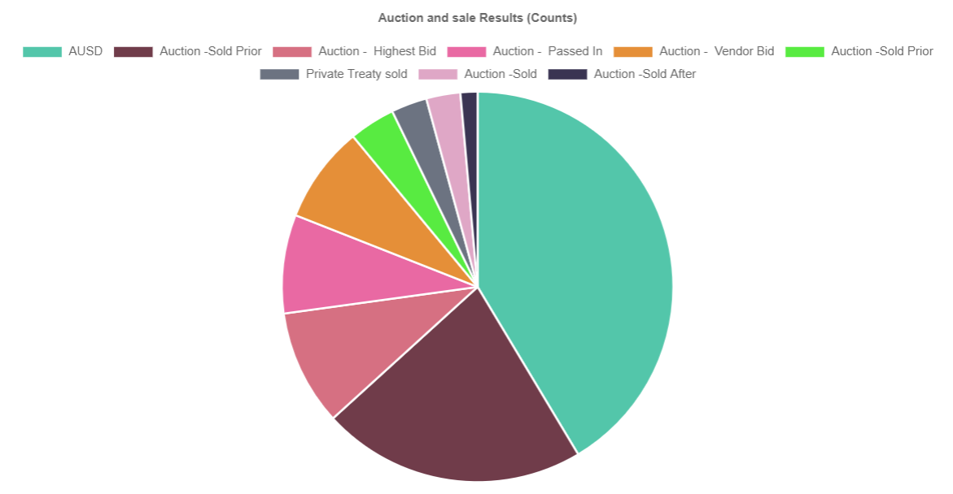
The pie chart displays:
More than 75% of the market sales take place in auctions.
It is very likely for a property to be sold at a higher price than the market since auctions are competitive.

Slide 5
Conclusions
According to the findings:
Purchasing properties in the north is the most feasible.
6 suburbs among the top 10
7 suburbs among top 15
East Melbourne is the second area for easy purchase.
1 suburbs in top 10
4 in the top 15
Home buyers may want to lower their expectations of their ideal price as they may have to enter a bidding war and eventually pay more than the initial estimate.
>75% of the market properties sold in auctions

